Slide 1
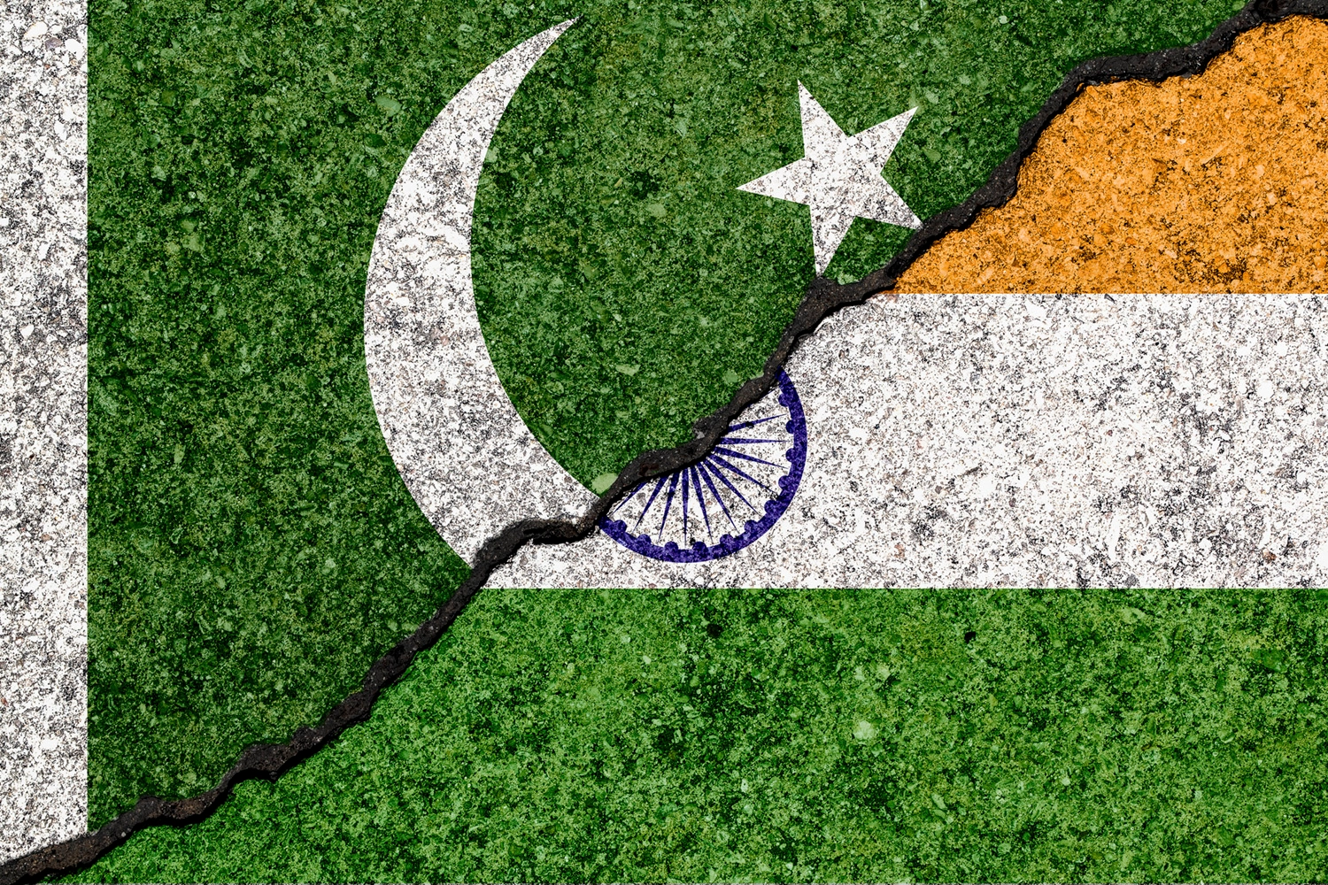


Slide 2

PRESENTED TO:
MAAM RABIA AKRAM
PRESENTEED BY:
MALKAH SIMRAHKHAN(F2022065037)
TAHIRA (F2022065017)
LAIBA ARIF(F2022065040)
HAJRA EMAN HAIDER(F2022065031)
UME YUSRA KHAN(F2022065009)
ROSHAN-E-ASIF(F2022065051)
MARFOWA KAINAT(F2022065035)

Slide 3
BACKGROUND OF MIGRATION:
After nearly two centuries of direct rule, the British handed over administration of the Indian subcontinent to the locals.
Under British rule, Indians had struggled for independence.
Among the most prominent anti-colonial figures were Mohammed Ali Jinnah, Mohandas Karamchand Gandhi and Jawaharlal Nehru. Their struggle ended with the British finally deciding to leave and handing over their power.
Jinnah and his party, All India Muslim League had rallied for an independent state for Muslims in South Asia.
When the British decided to leave, they devised a Partition Plan, which announced the creation of two independent states.
Pakistan was to become a homeland for the Muslims of South Asia after independence.
A Boundary Commission was set up to demarcate borders, which were formally announced on 17 August 1947. However, Pakistan came into being on the 14 August 1947 and many Muslims from all over India made their way to the new country.

Slide 4
INTRODUCTION
Two largest Muslim majority provinces, Bengal and Punjab, were partitioned.
The Assemblies of West Punjab, East Bengal and Sindh and in Balochistan, the Quetta Municipality, and the Shahi Jirga voted for Pakistan.
Millions of Indians flee their homes from India to a newly-formed Pakistan, or in the opposite direction.
In August 1947, around 12-15 million people fled their homes from one side of a new border within the former British colony of India to the other.
Based on 1951 census of displaced persons, 7,226,000 Muslims went to Pakistan from India while 7,249,000 Hindus and Sikhs moved to India from Pakistan immediately after partition.

Slide 5
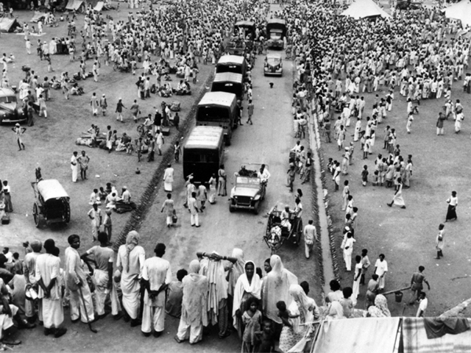
The Great Migration
The summer of 1947 witnessed the biggest mass migration in human history.
Those who could afford to, left in planes, ships or special trains. Hence most took regular trains and the poorest of the poor travelled on foot.
The journeys of those who migrated were fraught with challenges and difficulty.
People often went hungry for days and diseases were rampant.
The riots and violence that they suffered just made it all the more difficult.
Trains would often arrive filled with only the dead bodies of the passengers.

Slide 6
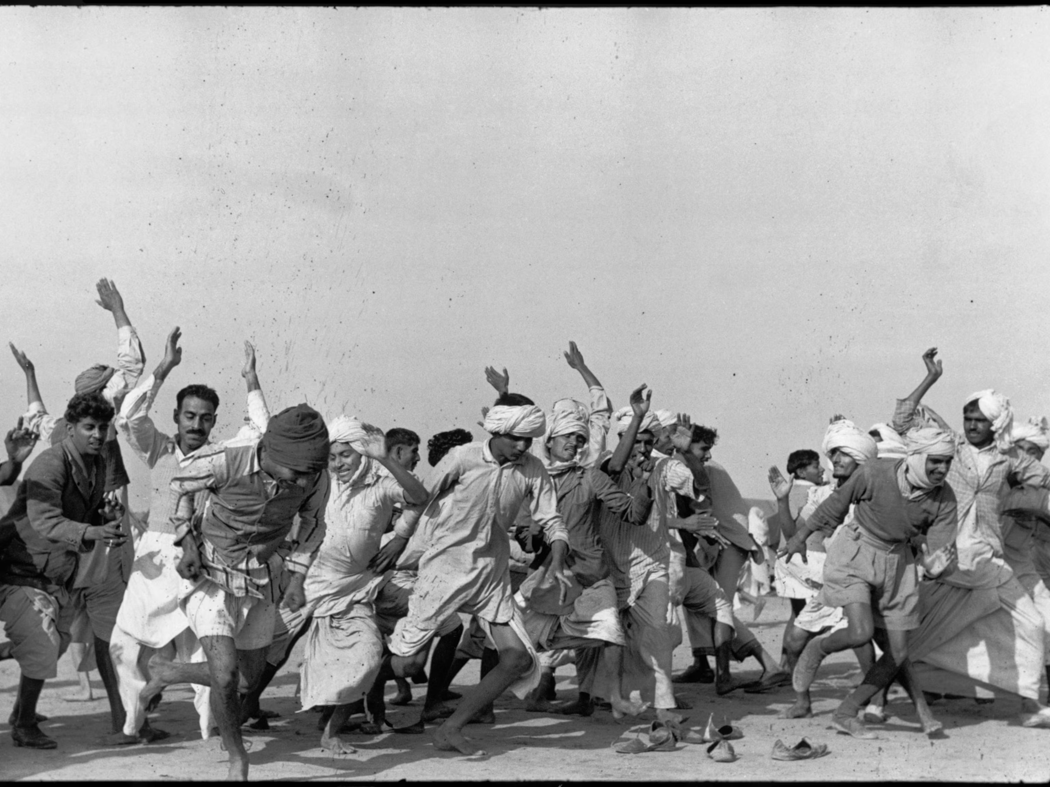
LOST OF LIVES DURING MIGRATION:
During migration, many masses were killed .
Hindus and Sikh massacre many Muslims while migrating towards Pakistan and in return Muslims also killed many Sikh and Hindus because of Red-Cliff injustice division of provinces.
Sikh and Hindus burnt houses and belongings of Muslims.
They also kidnapped women of Muslims and betrayed them.

Slide 7
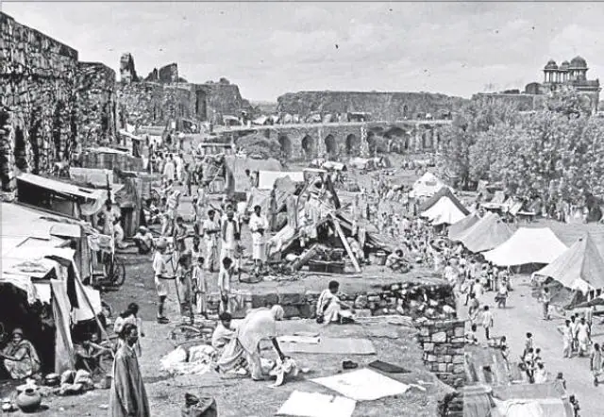
DIFFICULTIES FACED DURING MIGRATION
A makeshift refugee camp on the route to Lahore, Pakistan. The set up in the background was typical for those who travelled on foot for all or some part of their journey.
They set up camp using the little belongings they had set off with, mostly on bullock carts.
Charpoys (South Asian jute beds) were covered with fabric and fortified with hay.
There were no proper arrangements for toilets or washing areas. Hence diseases like cholera and typhus spread rapidly, claiming many lives.
Shortage of Food and Hospitals.

Slide 8
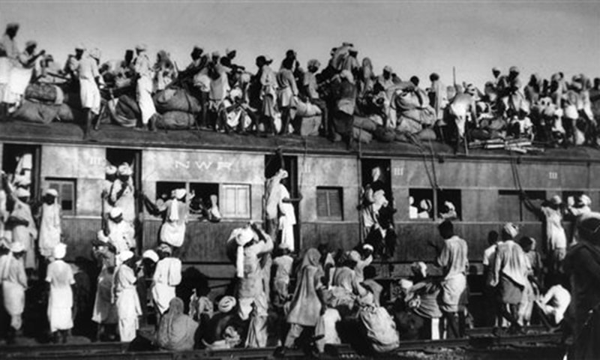
Continue…
A train filled with refuges arriving at Lahore Station from India.
The trains carrying the refuges would be more filled more than capacity. There were people inside the train, clinging onto the sides of carriages and on top.
Due to the overcrowded nature of the trains, people travelled in appalling conditions.
Migration of some refugees from East Punjab (India) to West Punjab (Pakistan) on a bullock cart.
An extended family is seated on a bullock cart with as many belongings as they could bring. Their journey would have lasted days, if not weeks.
Both the people and animals bore the brunt of Partition.

Slide 9
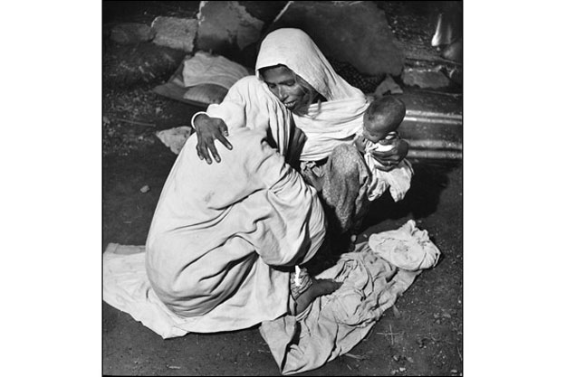
PEOPLE LOST DURING MIGRATION:
A woman with her family, making her way to Lahore. Displaced from her home somewhere in India and very likely to have made it through a rough and challenging journey, the feelings of exhaustion and relief are evident on her and her family members' faces.

Slide 10
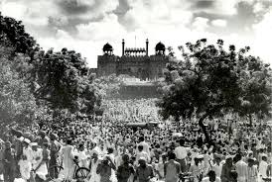
Refuge Camps
Partition saw the division of the Province of Punjab. During the British Raj, it had a Muslim and non-Muslim ratio of roughly 1:1.
Upon the announcement of Partition, Hindus, Sikhs and Muslims who had been friends and neighbours became some of the fiercest foes.
As the independence neared, riots and mass killings ensued. Punjab, thus witnessed the bloodiest and one of the largest migrations of people.
Camps were set up at various points along both sides of the border.
This section showcases images from 1947 and the conditions of the migrants coming into Pakistan from India.

Slide 11

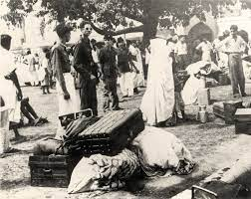
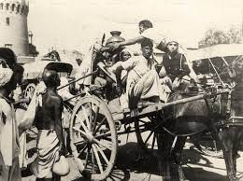
A group of refugees waiting to settle into their camps.
The refugee camps lacked basic arrangements.
People used tents,
fabric, sticks and charpoys to create shelters for themselves.
Volunteers are standing at Lahore Railway Station. They were helping the incoming refugees. The refugees' luggage has been piled up and they were waiting to be given a space to settle at a camp.
Volunteers distributing water to the refugees at Walton camp. They are on a horse cart suggests that they were distributing huge volumes of water, indicative of the number of people they were helping. Walton was one of the biggest refugee camps in Lahore.

Slide 12
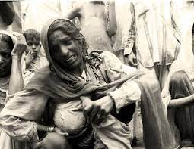
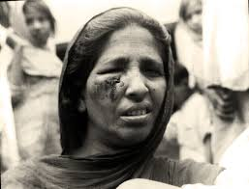
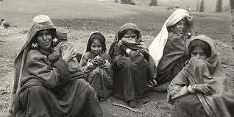
Silent Warriors: The Women of Partition:
Women were among the worst affected victims of Partition.
Many of the abducted women were forcefully converted to the abductors' religion, who also often married them against their will. There are several accounts of women and girls giving up their own lives by jumping into wells, choosing death over the fate that may have awaited them otherwise.
The injured woman lamenting her fate, perhaps rubbing off tears, or trying to hide her face. Many refugees were in dire need of medical care upon arrival at the camps.
A woman among the refugees exposing her body to show the bruises she has endured.
A group of female refugees with their children. Both the women and children are in a bad state with torn or no clothes at all. They seem to have taken shelter in one of the then recently evacuated properties, abandoned by those who left for India.
Many women also gave birth to children in camps.

Slide 13
AFTER EFFECTS OF MIGRATION
Lack of hospitals.
Spreading of various diseases.
Shortage of clothes, beds and shelters.
A lot of economical crisis due to the injustice division of subcontinent, all indrustrial areas were allocated to India.
Conflict of water as rivers were coming from India and they stopped water supply.
Shortage of educational institutes.
Difficulty in official work as, Britisher and Indian officers burnt the official records and offices.
Ethnical problems due to migration.
Language issues in west and east Pakistan.

Slide 14
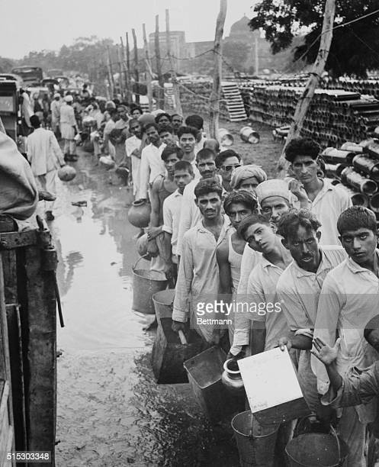
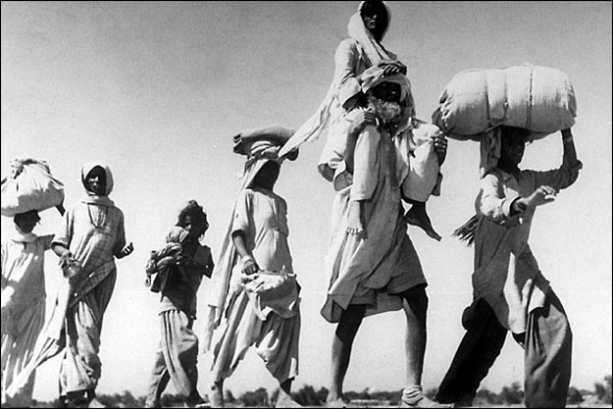
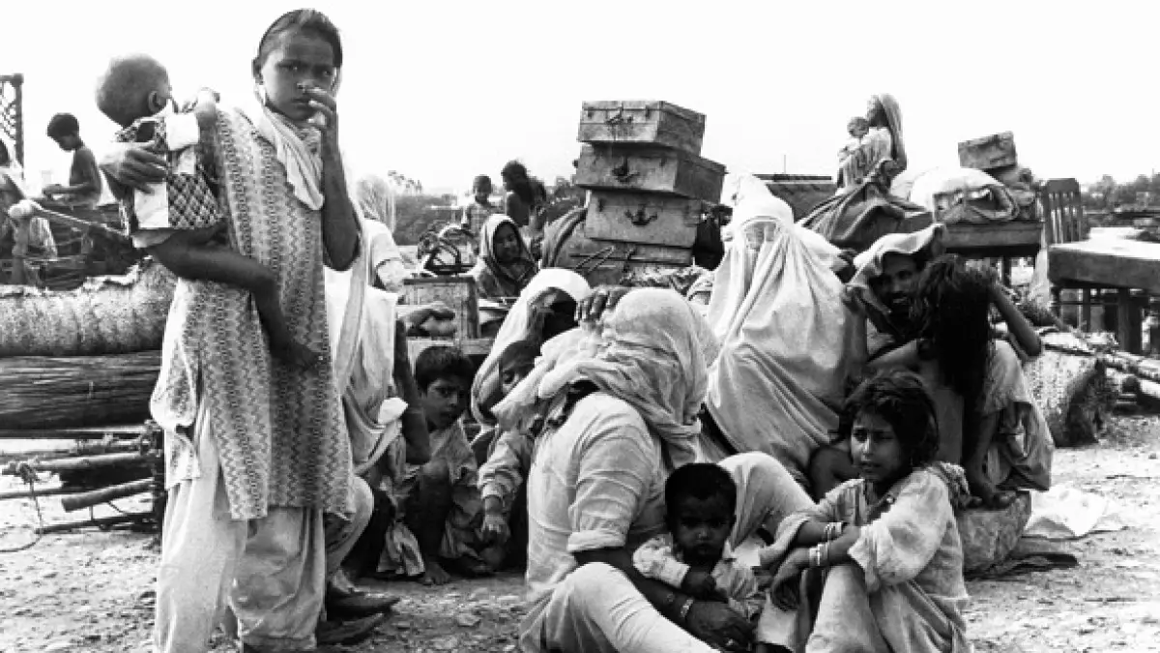
SOME PICRURES OF MIGRATION 1947
People waiting for food
People while migrating
People waiting for shelter

Slide 15
SOLUTIONS MADE TO ASSIST PEOPLE
The hospital appears to have been set up in a verandah of a building with no doors. The open space has been covered with dark fabric and patients are waiting outside.
Each household was given a ration card. Often families who lost loved ones at the camp did not declare their demise fearing a cut in ration. Usually volunteers were drawn from those who could read and write from amongst the refugees to assist with the rationing.
Clothes were being distributed by different volunteers.
Starting to build different indrustries .
Educational institutes were made under open sky.
Officers starts working by sitting outside under sky.

Slide 16
THANK YOU

